Slide 1

Electrocardiogram (ECG) Signal Classification
Yongjie Yang; Xueteng Qian
04/19/2022
Notes:
Hello everyone. Today we would like to share with you our recent research project on ECG heart signal classification.
My name is Yongjie, and my partner’s name is Xueteng.

Slide 2

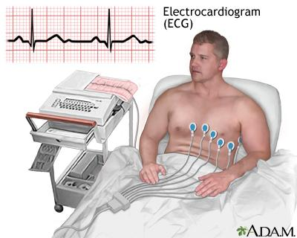
Motivation: Heart diseases are always been a problem
A terrifying number
About 659,000 people in the United States die
from heart disease each year
Electrocardiogram (ECG)
An electrocardiogram (ECG) is one of the simplest
and the fastest tests used to evaluate the heart.
Heart Disease Death Rates, 2014-2016, United States

Slide 3
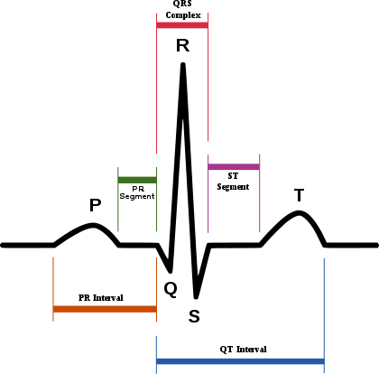
Motivation: ECG signal
Use multi-lead for ECG detection
A complete period ECG signal

Slide 4
Motivation: Dataset from MIT-BIH Arrhythmia Database
Database:
48 half-hour excerpts of two-channel ambulatory ECG recordings.
23 recordings of patients from Boston's Beth Israel Hospital
25 recordings were selected from the same set in a small random sample.
Segmentation:
Record 1 second as 1 heartbeat, due to catching the R wave.
1 second divided into 360 samples.
Only care about 5 heart statuses.
(N) | Normal beats
(L) | Left bundle branch block
(R) | Right bundle branch block
(A) | Atrial premature contraction
(V) | Ventricular premature contraction

Slide 5
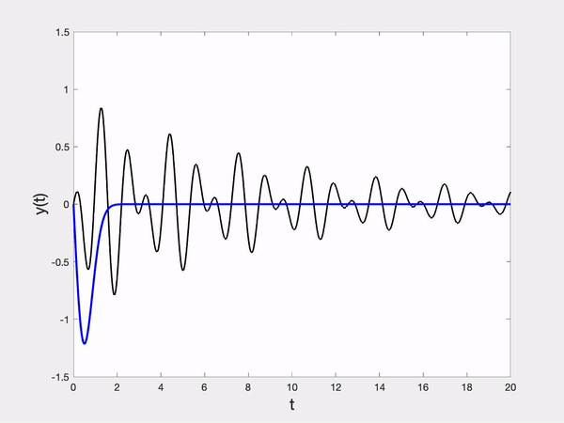
Signal pre-processing method: Wavelet transform for the dataset
Challenge:
Discrete waves with a long time period.
General Principle:
Specialization to target one complete ECG signal for a better performance-resource tradeoff.
© https://builtin.com/data-science/wavelet-transform

Slide 6
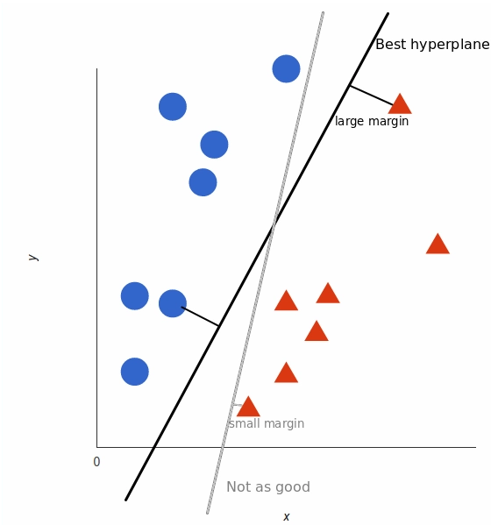
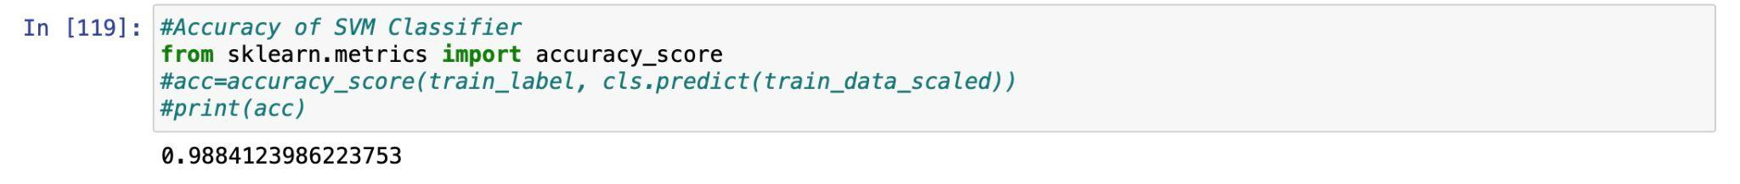
Model 1: Support vector machine (SVM)
Non-linear supervised model.
Principle: SVMs can efficiently perform this model and implicitly mapping their inputs into high-dimensional feature spaces, then use binary classification.
The ratio of the test set to the data set: 30%
SVM model performance: 0.988

Slide 7
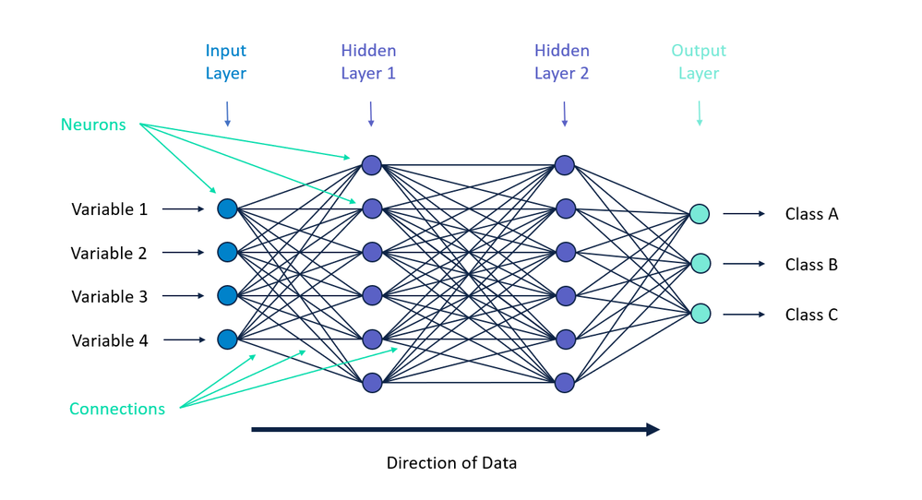
Model 2: Convolutional Neural Network
Idea:
They are made up of neurons that have learnable weights and biases.
Three layers:
Input layer, Hidden layer, and Output layer.
ECG signal
Convolutional layer and pooling layer
Fully-Connected layer
©https://community.alteryx.com/t5/Data-Science/It-s-a-No-Brainer-An-Introduction-to-Neural-Networks/ba-p/300479

Slide 8
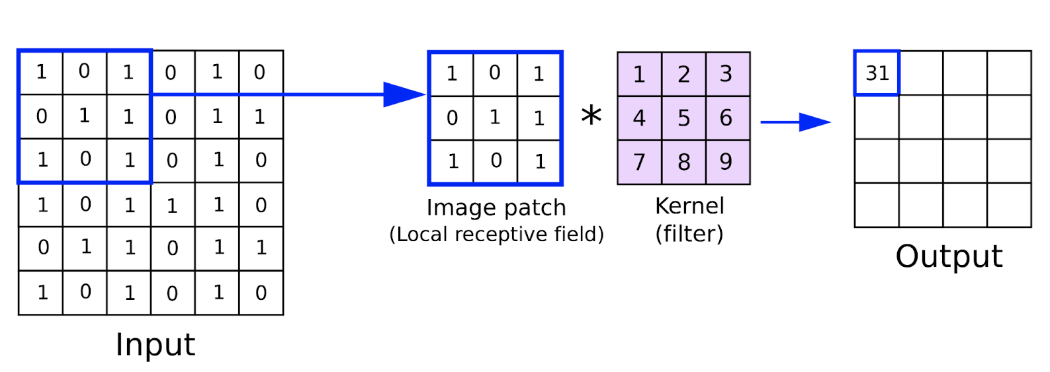

Model 2: Convolutional Neural Network
Convolutional layer:
©https://blog.csdn.net/Dontla/article/details/104119887

Slide 9
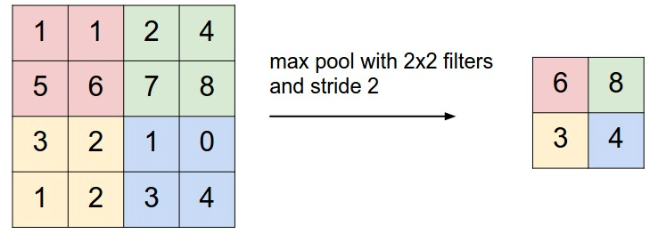
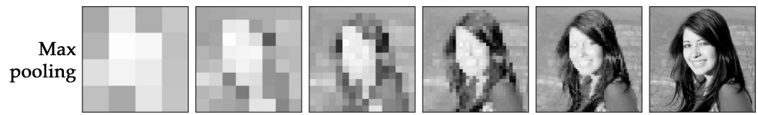
Model 2: Convolutional Neural Network
Pooling layer:
©https://proceedings.neurips.cc/paper/2015/file/536a76f94cf7535158f66cfbd4b113b6-Paper.pdf

Slide 10
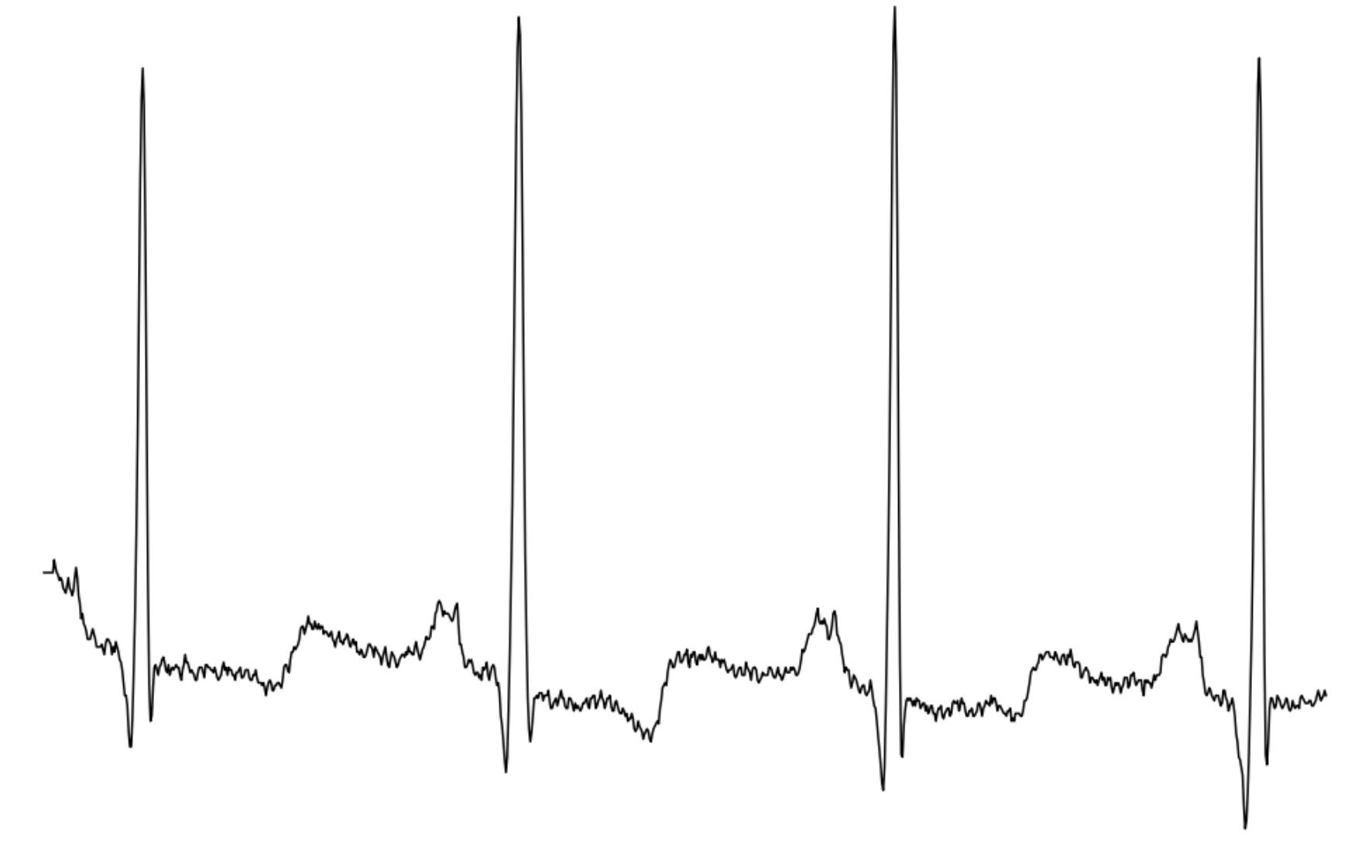
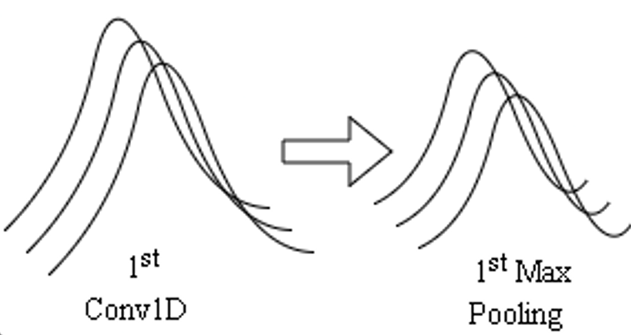

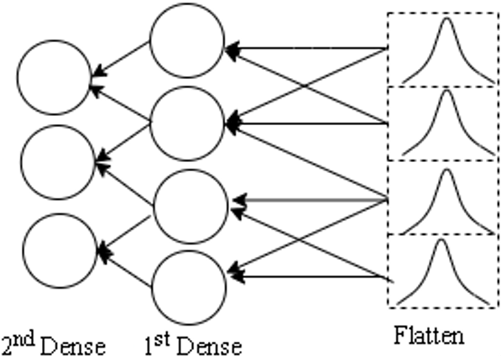
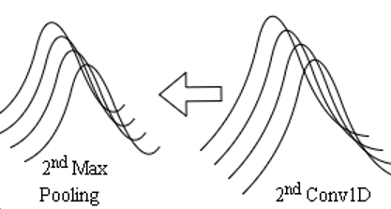
Model 2: Convolutional Neural Network
1st Conv1D
1st Max Pooling
Duel-lead ECG inputs
Output
Flatten
2nd Max Pooling
2nd Conv1D

Slide 11
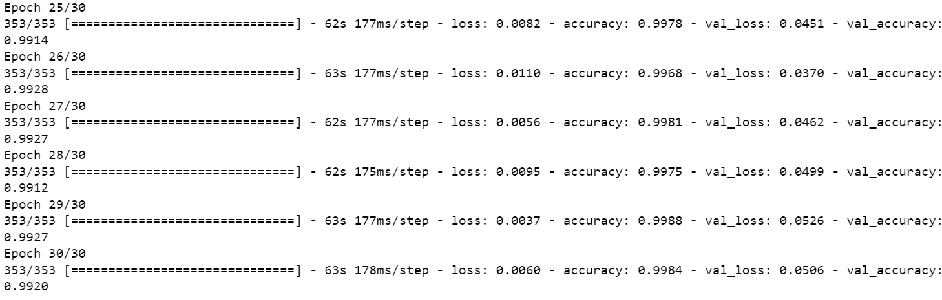
Evaluation:
Training dataset performance
The ratio of the test set to the data set: 30%
Training parameters: 30 epochs, 0.001 learning rate, 128 batch size, and adam optimizer.
The accuracy of the CNN model: 0.992.

Slide 12
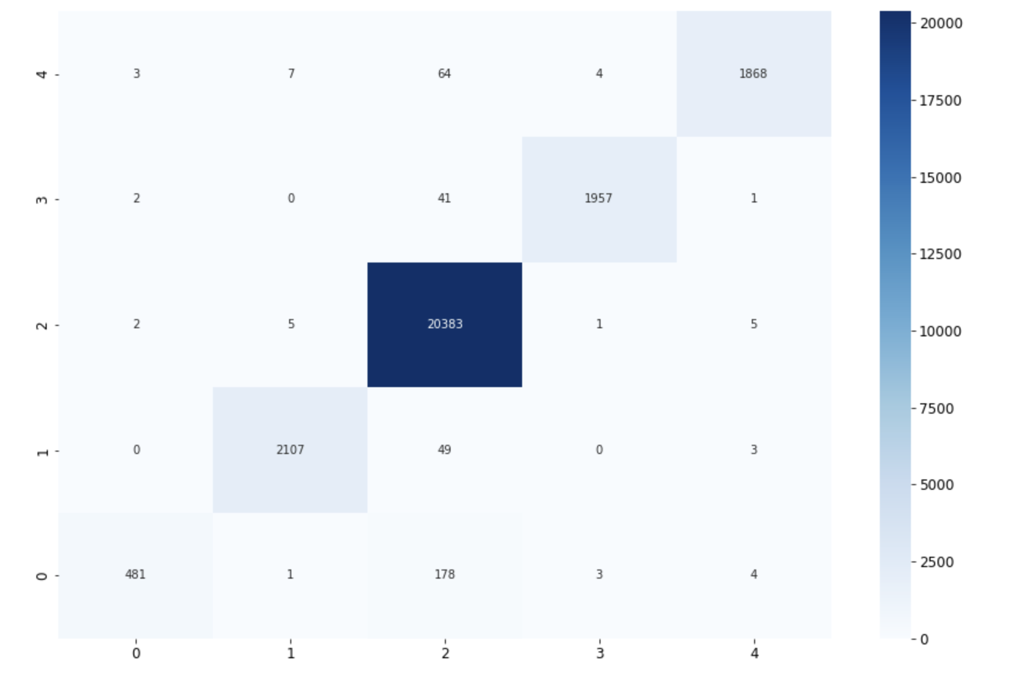
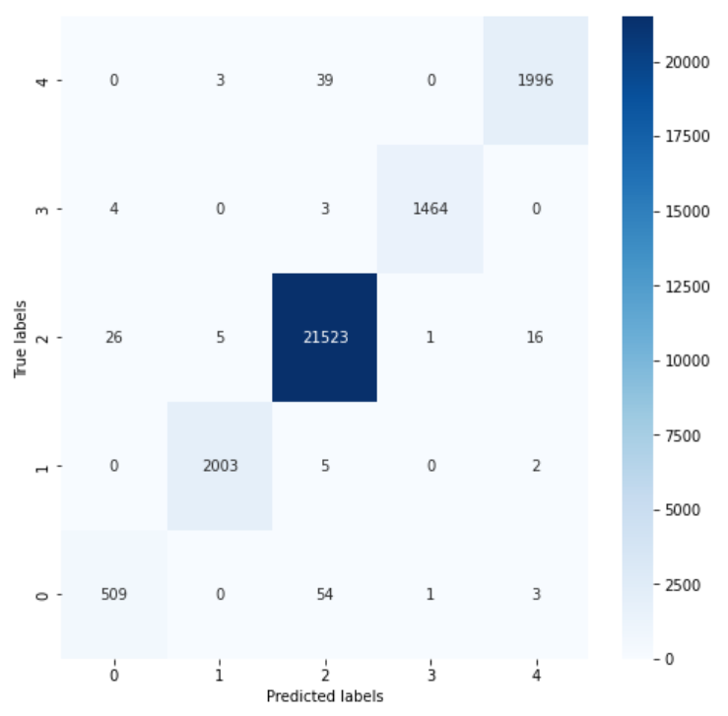
Results: Comparison between SVM and CNN
SVM Results
CNN Results
0 | (A) | Atrial premature contraction
1 | (L) | Left bundle branch block
2 | (N) | Normal beats
3 | (R) | Right bundle branch block
4 | (V) | Ventricular premature contraction

Slide 13
Discussion:
Unbalanced dataset:
The distribution of N, A, V, L, and R is unbalanced.
K-fold cross-validation.
The dataset also contains different attributes, such as gender, or age.
Notes:
Take way rather than discussion

Slide 14
Thanks!
Q&A
Notes:
and with this I will close my talk and I’m happy to take questions.

Slide 15
Supplementary: Distinguish 5 heart beats
Find the R wave of each heartbeat.
Each heartbeat has 360 samples. Then we set 160 samples before the R wave, and 200 samples after the R wave.
0 | (A) | Atrial premature contraction
1 | (L) | Left bundle branch block
2 | (N) | Normal beats
3 | (R) | Right bundle branch block
4 | (V) | Ventricular premature contraction
Five-status heartbeats
A complete period ECG signal
Notes:
1
First, we have to annotate the R peak. Then we divide the 1-second recording into 360 samples.
The Atrial premature contraction will have a super longer P wave
The left bundle branch block will have a large peak Q wave.
The right bundle branch block will have a broader and deeper S wave
And the last one, Ventricular premature contraction represents QRS complex has a longer wave

